Slide 1
Pursing Your Teaching Passion through the Program for Instructional Excellence (PIE):
An Overview of Services
Presented by Caity Kelly, PIE Assistant Director & Dr. Lisa Liseno, PIE Director

Slide 2
PIE Workshop Guidelines
This workshop will consist of a presentation as well as time for Q&A and networking with colleagues.
We will have a short break for pie and coffee!
Please feel free to connect with PIE staff as well as your colleagues and make connections!
For our Zoom audience – it is very important that you remain muted to avoid feedback from conflicting microphones. If you have questions/comments, please feel free to use the Zoom chat function.

Slide 3
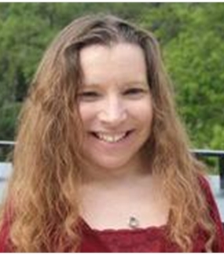
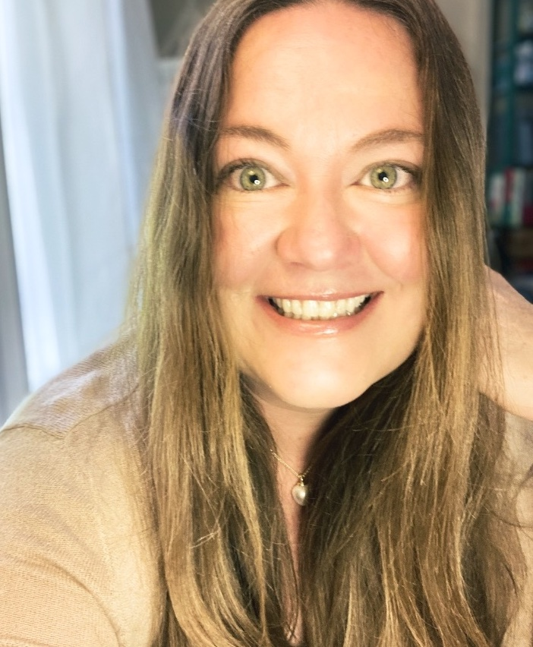
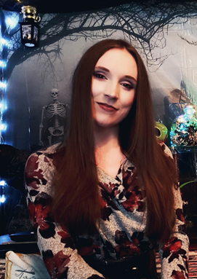
Introductions: PIE Staff
Dr. Lisa Liseno
Assistant Dean, The Graduate School, FSU
Director, The Program for Instructional Excellence
Director, The Fellows Society
4001E Honors, Scholars, and Fellows House
E-mail address: lliseno@admin.fsu.edu
Jen Adams
PIE Graduate Assistant
PhD Candidate, Department of English
Caity Kelly, M.S.
Assistant Director, PIE & The Fellows Society at FSU
FSU Alumnus; bachelor’s in Psychology & Master’s in Instructional Systems and Learning Technologies

Slide 4
Learning Objectives
Workshop attendees will be able to:
Describe the responsibilities and professional growth opportunities offered by the Teaching Assistant position.
List training and professional development opportunities linked to the TA position.
Record TA work/trainings on a CV or resume.

Slide 5
Introductions: What is PIE?
From Our Website: https://pie.fsu.edu/
“The Program for Instructional Excellence (PIE), a unit of The Graduate School, strives to enrich the learning experience for undergraduate students at FSU by supporting the teaching efforts of graduate student teaching assistants through its various services. PIE offers professional development programs that create opportunities to foster a sense of collaboration and community among all graduate student teaching assistants, and any graduate student interested in learning best practices in teaching and learning while at FSU.”
University-wide required TA Training
Professional Development Workshops
Teaching Support/Development Resources
Recognition for Outstanding TAs
Overall Community for Teaching/Learning

Slide 6
Part 1:
What is a TA?
Notes:
Ask the audience to say what they know about TAs

Slide 7
A Few Definitions
“A teaching assistant or teacher's aide (TA) or education assistant (EA) or team teacher (TT) is an individual who assists a teacher with instructional responsibilities. TAs include graduate teaching assistants (GTAs), who are graduate students; undergraduate teaching assistants (UTAs), who are undergraduate students; secondary school TAs, who are either high school students or adults; and elementary school TAs, who are adults (also known as paraprofessional educators or teacher's aides).”
-Definition from https://en.wikipedia.org/wiki/Teaching_assistant
Different institutions = Different qualifications
Provide various degrees of assistance in educational endeavors
May be directly or indirectly related to their field of study
Notes:
Point out that they will need to study the position at their chosen institutions. As this wiki article outlines, different organizations may have different qualifications and requirements regarding who is assigned a TA position. Within the institution itself, the TA position also varies.

Slide 8
General Roles & Responsibilities
Different TA roles = Different tasks
Varying independence
Varying hours per week
Tasks may include:
Grading
Providing feedback
Course design/management
Recitation facilitation
Test proctoring
Running labs
Fielding emails/questions
Holding office hours
Teaching the entire course
VS
Notes:
Pictures: Roles may range from behind the scenes work to being front and center teaching the class

Slide 9
A Closer Look at Roles
Behind-the-Scenes
Grade assignments/quizzes/exams
Provide feedback on work/activities
Update/manage course content
Planning/organization with the instructor of record
Create review materials/activities
Track/manage data
Labs/Recitations
Manage/proctor recitation activities
Monitor/proctor exams/quizzes
Manage lab activities
Conduct review sessions
Troubleshoot problem areas
Hold office hours

Slide 10
A Closer Look at Roles
“There is no magic “best” way to teach; many different styles work as long as the instructor engages students in the active learning process and conveys enthusiasm for his/her discipline.”
-Dr. Lisa Liseno
Instructor of Record
Highest degree of responsibility
Build/manage course content
Manage students
Deliver content
Grade/feedback
Answer questions/emails
May or may not include additional assistance

Slide 11
Common Tasks, Regardless of Roles
Coordination with your supervisor
Tracking student progress
Fielding emails
Holding office hours
Answering simple questions about course content/syllabus info
Notes:
You will need to work closely with your supervisor throughout the semester. You may be tracking some kind of student progress, be that grades or who has completed what tasks. You may need to answer questions and hold office hours. In general, it is necessary to be familiar with the content of the course itself and the policies and organization of the course setup so that you can address questions that may come to you.

Slide 12
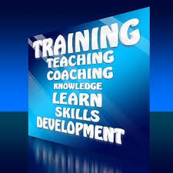
Part 2:
What does it take to be a TA?

Slide 13
Important Knowledge
Things you need to learn for this role may include:
Institutional policies
Academic calendar
TA standards
Required training/professional development opportunities
Institutional resources for TAs
Best practices in teaching/pedagogy
Campus facilities (in person)

Slide 14
Important Skills & Abilities
Skills you may need to foster for this role include:
Communication (written, verbal, etc.)
Organization (time management, work space organization, etc.)
Professionalism (dress, behavior, interactions, etc.)
Mentoring/feedback (objectivity, clear direction for strengths/improvements)
Public speaking (in more advanced roles)
Simplification of concepts (new vs. advanced learners)
Empathy/understanding
Establishing rapport/engagement
Fostering inclusivity

Slide 15
TA Training: A PIE Example
University-Wide Required Training
All TAs at FSU must work with their departments and PIE to determine training requirements
TA position is dependent on successful training completion
Topics may include (but are not limited to):
Major FSU policies
FSU tech for teaching
Syllabus/learning objectives
Classroom management/engagement
Grading
Diversity, equity, & inclusion
Accessibility
Resources at FSU
Notes:
Remind audience that this may differ at their institution but it is important to investigate these types of requirements for your TA position. Our training is intensive and it is a time commitment but it is a fantastic addition to your resume due to the impressive scope of its content.

Slide 16
How to Prepare for Seeking a Position
Talk to current TAs
Research TA standards and roles at FSU/your institution of choice-requirements, tasks, qualifications, training, etc.
Record any tutoring/mentorship/leadership experiece you may have achieved during undergraduate/graduate school opportunities
Educate yourself on best teaching practices through various resources
A Few More Notes
Some colleges require at least 1 semester of grad school experience; others do not
Network with your colleagues--faculty, peers, staff. Etc.
Show genuine interest in your field--ask questions, go to office hours, reach out to express interest in a TA position
Reach out early to express interest in TA/GA positions – Professors, Advisor, etc.

Slide 17
Time for a pie & coffee break! – 15 minutes
Take a few minutes to stretch your legs, get some refreshments, and connect with your colleagues!
At your tables, you will see the “PIE Planner: Networking & Preparing for a TA Position” handout.
As we take time to enjoy refreshments and network with colleagues, feel free to make notes on the planner regarding steps you might take to secure a TA position. You can also use this document to write down the email of anyone you meet here today!
If you already have a TA position, please feel free to share advice with other graduate students.
For our Zoom audience – feel free to chat in the Zoom chat space and to grab your own personal refreshments during the break!

Slide 18
Part 3:
What will the TA role do for your professional growth?

Slide 19
General Assets
Leadership
Teaching/public speaking experience
Mentorship/feedback experience
Time management
Communication
Written/verbal skill development
Coordination with colleagues/supervisors
Professional interaction/management of students
Practice with your field/research
Thorough knowledge/ability to break down topic
Discussing research/alternative perspectives with students
Experience with teaching tools/technologies
LMS experience
General software/tech experience

Slide 20
Caity’s Experience
TA position 2nd semester of graduate school (networking is key)
Online TA for graduate level Theories of Learning and Cognition in Instruction
PIE training done preemptively
Tasks
Setup/management for Canvas
Field emails
Create practice resources
Track/report student progress
Review student submissions/provide detailed feedback
Experience
LMS management/organization
Classroom management
Professional communication
Quality assessment/feedback writing
Bolstered CV for future GA positions
Learning & Cognition

Slide 21
Dr. Liseno’s Experience
Offered TA position with acceptance into terminal MA Philosophy program at Northern Illinois University
Assisted faculty with grading, held office hours, etc.
Offered TA position with acceptance into PhD program in Philosophy at FSU
Completed PIE TA Training required before fall classes began
Department decided TA roles
1st Fall & Spring: TA supporting another (more experienced) IOR TA Intro. Courses – My TA role included leading discussion sections/recitations
Summer semester onward: Assumed TA position as primary Instructor of Record (IOR) & supervising other TAs assigned to assist me

Slide 22
PIE Resources
Feel free to reach out to us at pie-info@fsu.edu for more information or if you’d like to chat about our programming!
PIE TA Community Support Site: https://canvas.fsu.edu/enroll/JB4D8K
PIE Coffee Hour & Teaching Workshop Series
Basics of Teaching Course (NOT the University-required TA training)
Pedagogy-based book clubs
TA Handbooks
Peer Teaching Observations
Outstanding Teaching Assistant Awards
*Check out all of PIE’s programming on our website: https://pie.fsu.edu/

Slide 23
Questions?

