Slide 1
STEM TA Panel

Slide 3
ABOUT ME
Yashika Garg (she/her/hers)
yg19d@my.fsu.edu
3rd year Cell and Molecular Biology PhD candidate
Teaching assistant for the last 5 years (2 at FSU)
2021-22 PIE Associate

Slide 4
What Is STEM?
SCIENCE- Discover and describe
A better understanding of life (What is)
TECHNOLOGY- Invent and innovate
How the natural world can be improved?
ENGINEERING- Control, modify, or design materials, processes, and systems
What could be?
MATHEMATICS- Symbolic language for representing reality
Makes sense of the world with numbers

Slide 5
Characteristics of a great STEM Lesson
Go to the link:
https://jamboard.google.com/d/1xtlD6oiEsrcGhdgL2Ju4RXGr6HnR_nAcxgQ_iPQnph8/edit?usp=sharing
Click on sticky notes on your left
Write your opinion in the sticky note, save it, drag the sticky note box and place it in the right category.

Slide 6
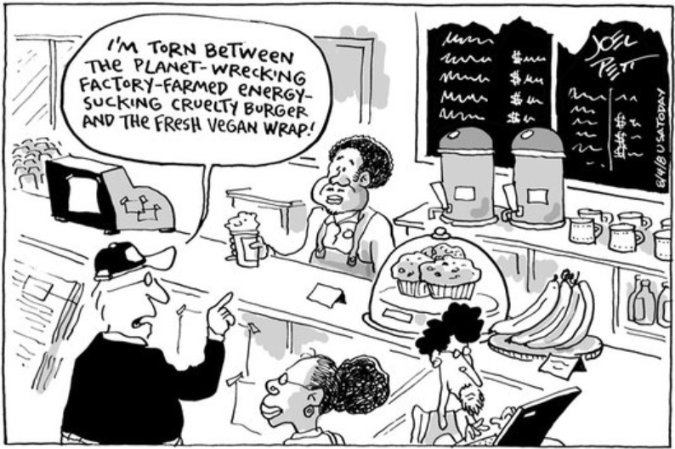
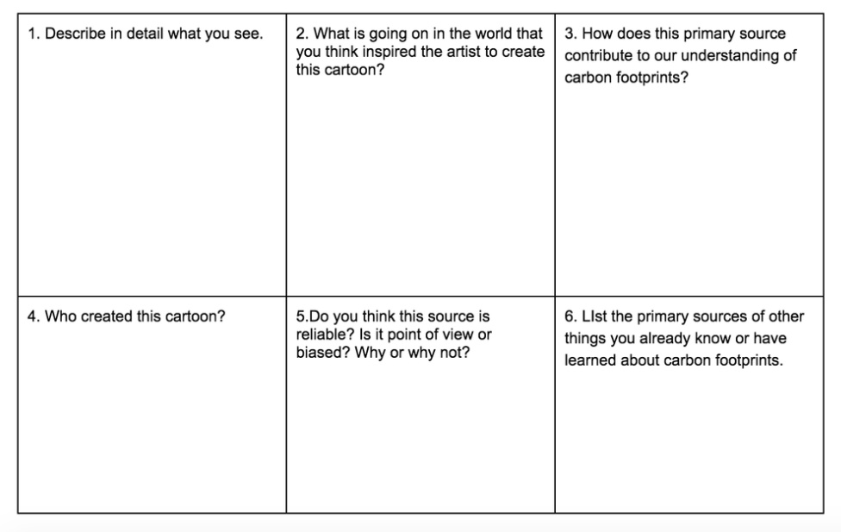
Focuses on real-world issues and problems

Slide 7
Guided by engineering design process
Design
Build
Test
Improve
Research

Slide 8
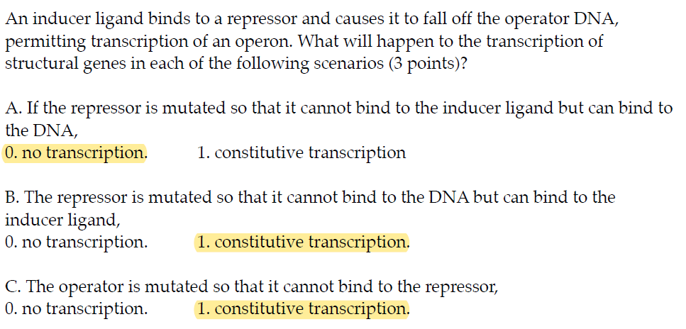
Allows for multiple right answers when variables are manipulated

Slide 9
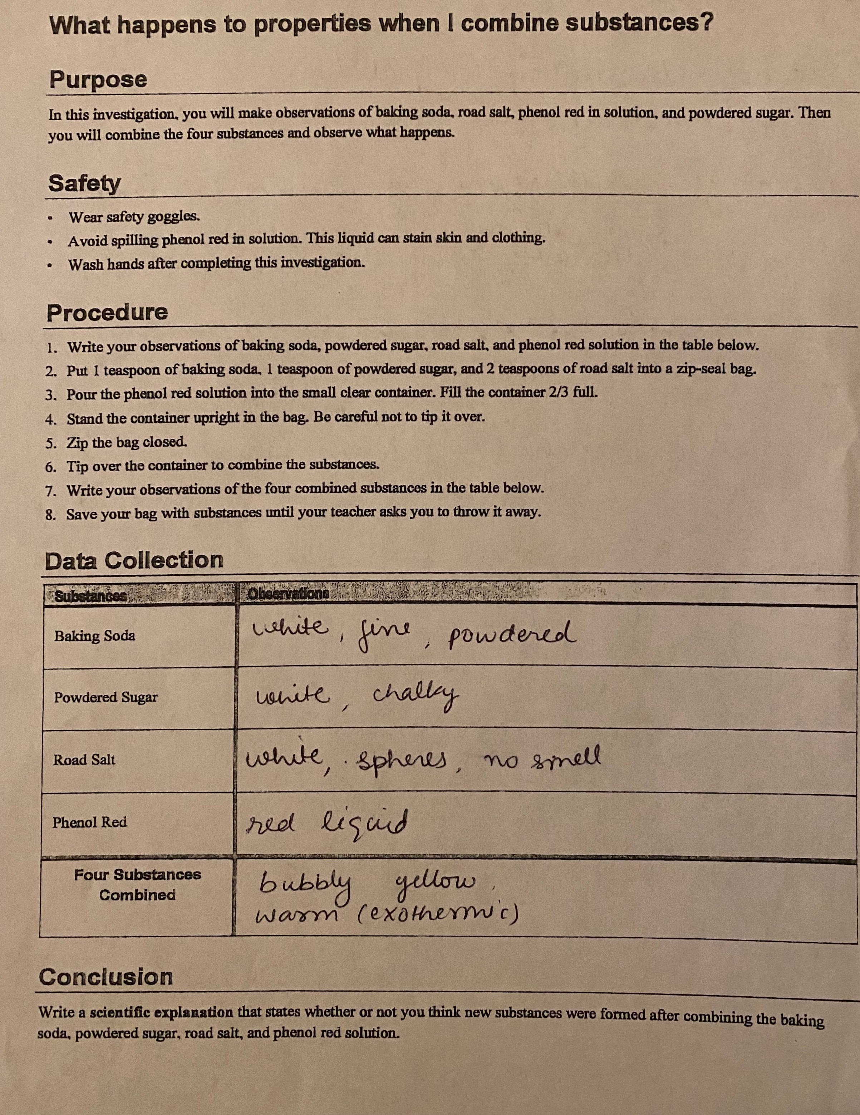
Helps developing Scientific Explanations
CLAIM
EVIDENCE
REASONING
REBUTTAL

Slide 10
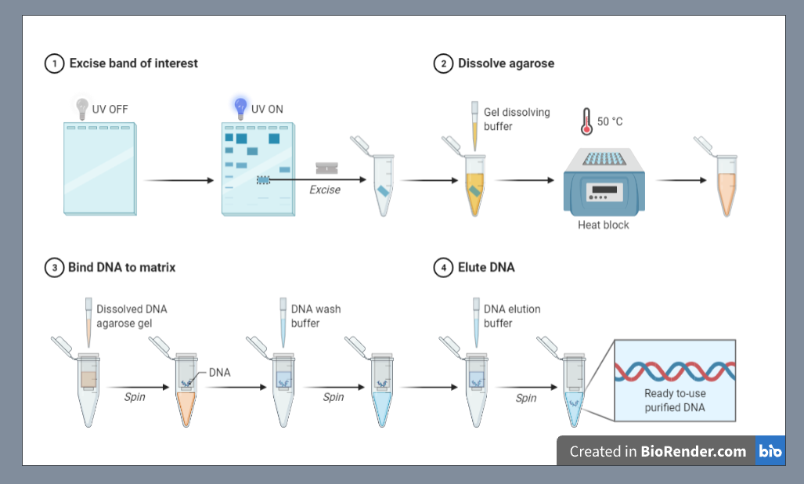
Wisdom Bombs
Create effective presentations
reduce hierarchy of slides by pictorial representations

Slide 11
Create an active learning environment
Flipped classroom (Works in graduate level courses)
Pre-class quiz
Should have a grading philosophy
Be clear on the set of directions for each type of questions

Slide 12
Project- based learning
Give timely and helpful grading feedback
Be available in-person and by email
Actively communicate with other TAs and your curator

Slide 13
Give learning tips to students
Making flashcards
Tabulate the complex information
Be an active teacher in a classroom
Give out candy on first day
Balance between daily tasks (research, coursework etc.) and TA responsibilities
Lab preparations and meetings
Time spent teaching
Grading
Office hours and emails
Notes:
Move around; you can’t reach your students while doing other work; be focused on the students; be excited about the class material

Slide 14
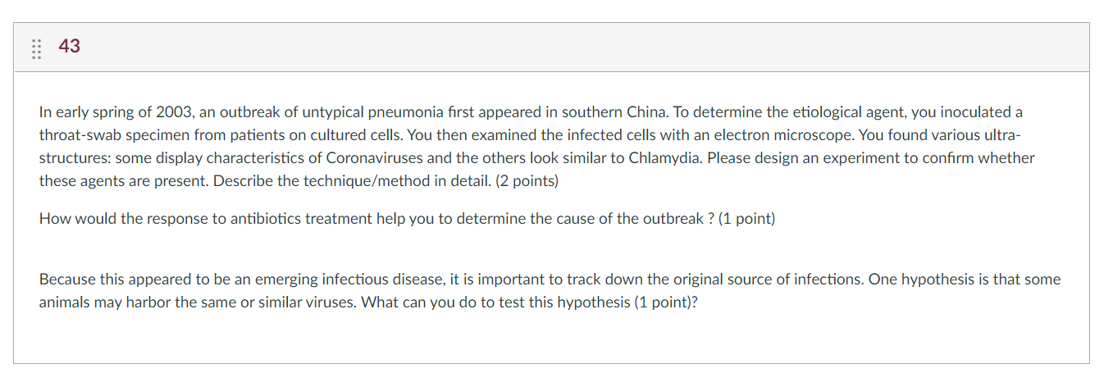
Use case studies
Develops their skills in problem solving and analytical tools
Encourage students to follow a systematic approach-
What is the issue?
What is the goal of the analysis?
What is the context of the problem?
What are the key facts to be considered?
What alternatives are available, and which one would you recommend?

Slide 15
THANK YOU

