Slide 1
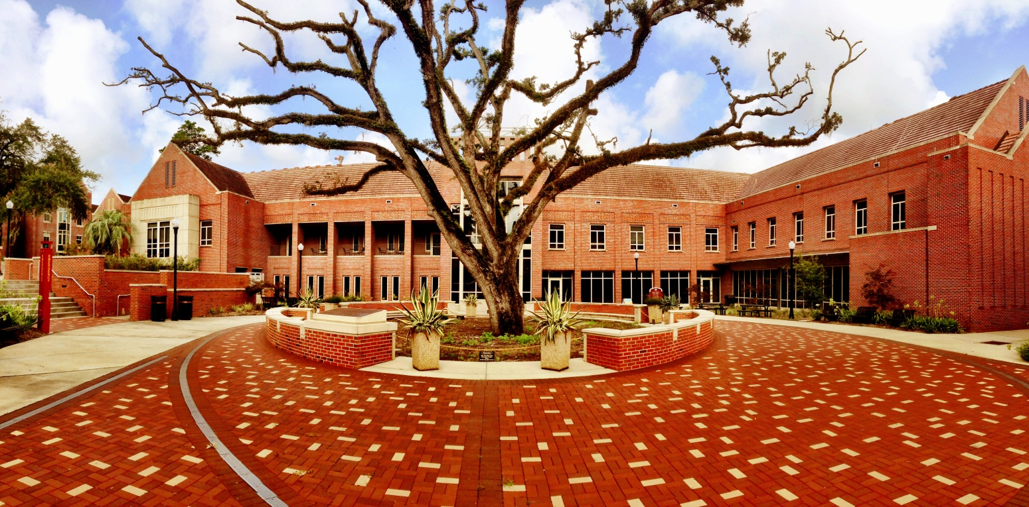
CAPS is Here to Help!
Counseling and Psychological Services
2nd Floor, Askew Student Life Center
850-644-TALK (8255) www.counseling.fsu.edu
Triage Appointments: Monday – Friday 8 am to 4 pm
After hours call same number 4 pm- 8 am daily

Slide 2
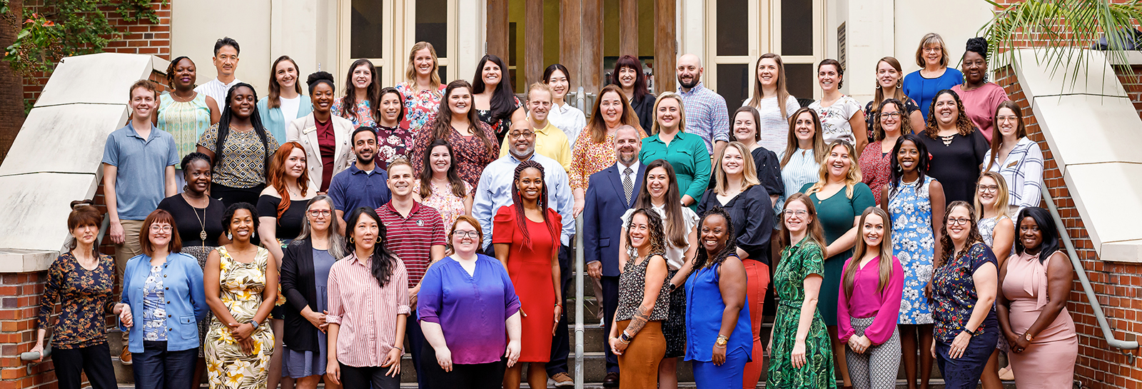
Who We Are
Licensed Psychologists
Licensed Mental Health Counselors
Licensed Clinical Social Workers
Licensed Marriage and Family
Counselors
Registered Art Therapists
Pre-doctoral Psychology Interns
Post-doctoral Psychology Residents
RENEW Undergraduate Peer-Educators
Check out our bios on our website!

Slide 3
Garnet & Goals
To Help Students
Function to the best of their abilities
Make the most of the years at FSU
To Provide
Free & confidential mental health services/referral to all enrolled students
To Support
Faculty, staff, and administrators in their efforts to provide a first- class educational experience at FSU
Notes:
CAPS Services Free, Confidential (What that means)
Hours, Location, Walk-Ins, Telephone, Individual, Groups, Couples (one must be enrolled)
EAP for staff members

Slide 4
Common Concerns
Alcohol/Drugs
Anger
Anxiety
Assertiveness
Depression
Discrimination
Eating Disorders
Family
Grief
Relationships
Self-Esteem
Sexual Abuse
Sexual Assault/Date Rape
Sexual Orientation
Sexuality
Social Isolation/ COVID-19
Stress
Study Skills/Test Anxiety
Suicidal Thoughts
Time Management

Slide 5
CAPS Services
Walk-In/Triage
Individual Counseling
Group Counseling
Single Session Therapy
Drop-In Psychoeducation, Interventional Workshops, Outreach Presentations
Treatment Coordination: Referral to Community
Notes:
Show website

Slide 6
Stress and Self-Care
Some stress is motivating but too much unmanaged stress can hurt and lead to burn-out!
Food for Thought: How are you balancing:
(1) Academic responsibilities
(2) Work/schedule demands
(3) Social obligations
(4) Personal relationships
(5) Own needs
Notes:
Show website

Slide 7
Relevant Stressors/Considerations
Graduate level coursework
Work hours and responsibilities as a TA/GA
Relationship with PI/Faculty
Relationship with students
Relationships with each other
Post-pandemic realities/life
Worry about the future
Big decisions
Conflict
News / Social Medial
Basic needs
Notes:
Show website

Slide 8
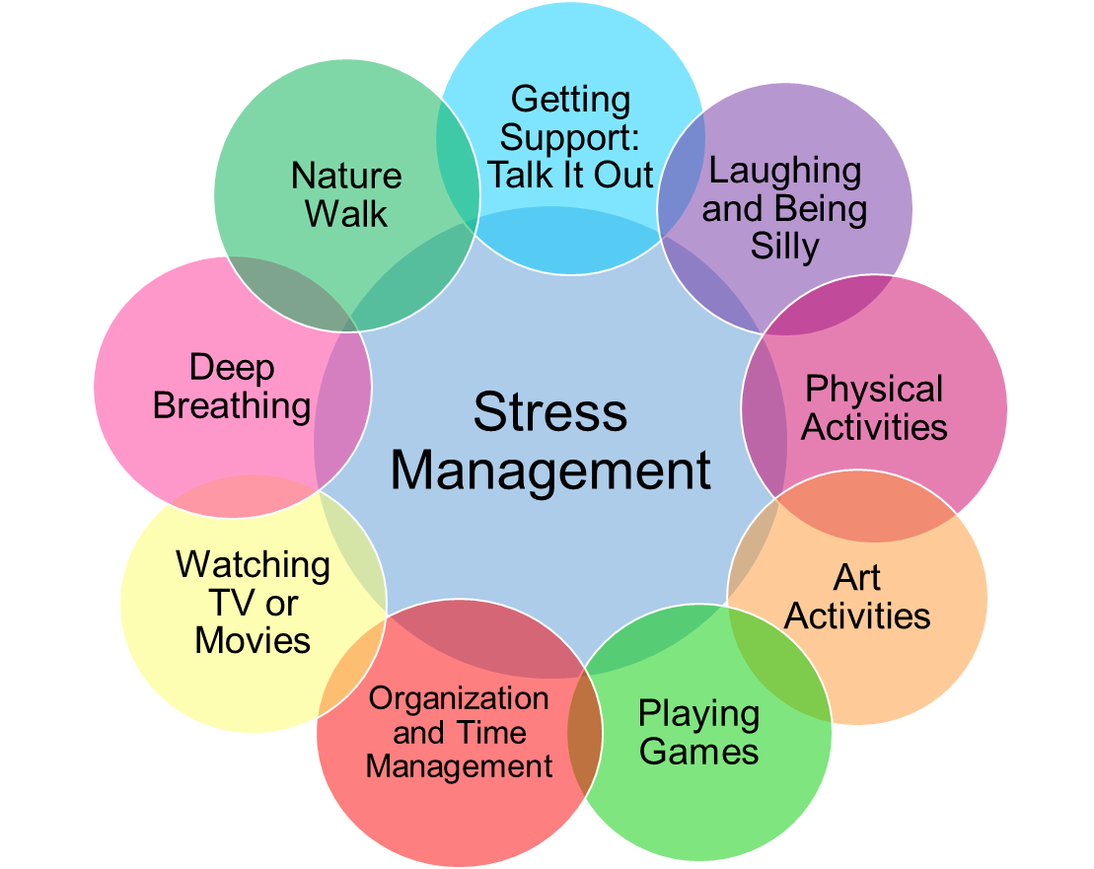
What can you do?
Notes:
Show website

Slide 9
Interpersonal Effectiveness
We can reduce the impact of stress and manage conflict better by being interpersonally effective and skillful!
How?
By communicating assertively
By setting boundaries
By expressing needs
By maintaining our self-respect
By strengthening supportive relationships and ending destructive ones
Notes:
Show website

Slide 10
What does this mean for me?
Clarify your values and priorities
Assess current relationship investments
Review your commitments
Manage your time well
Learn to ask for help and to say no
Build in leisure and pleasure into each day

Slide 11
Questions? Feedback? Thank you!

