Slide 1
Let’s Discuss Specifications Grading
Vanessa P. Dennen
Lauren M. Bagdy
Instructional Systems & Learning Technologies
Florida State University
PIE Workshop
September 1, 2021

Slide 2
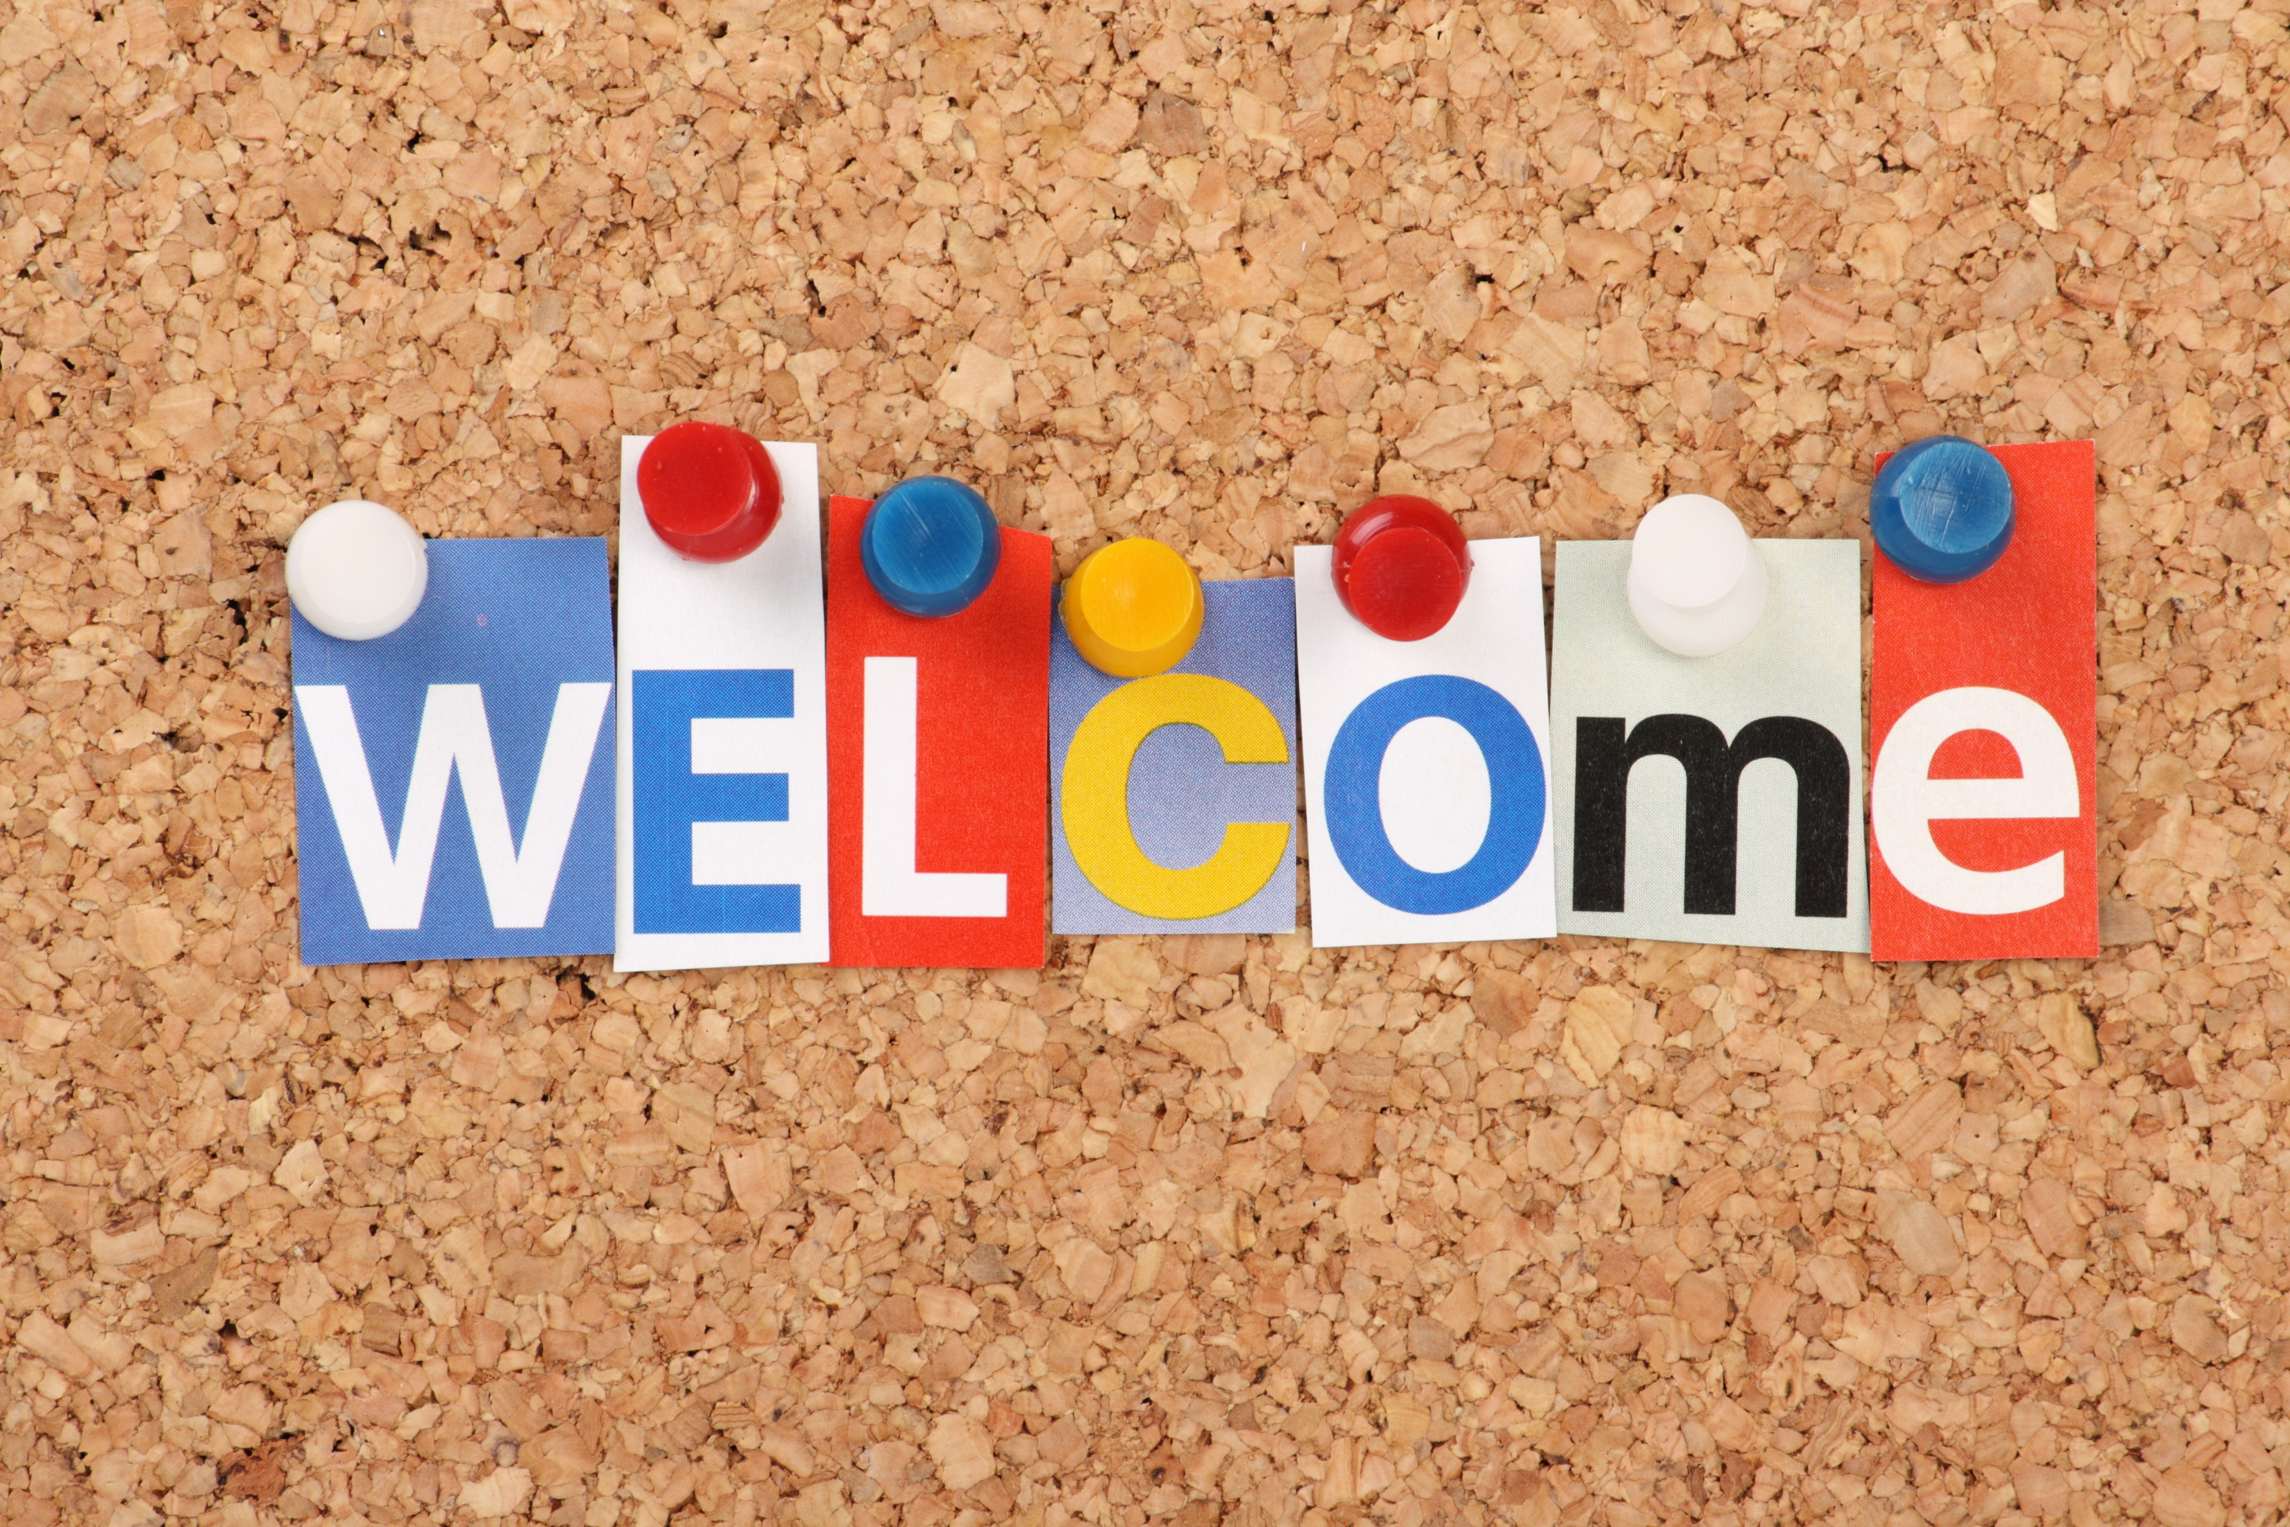
Let’s Get Acquainted!
This Photo by Unknown author is licensed under CC BY.

Slide 3
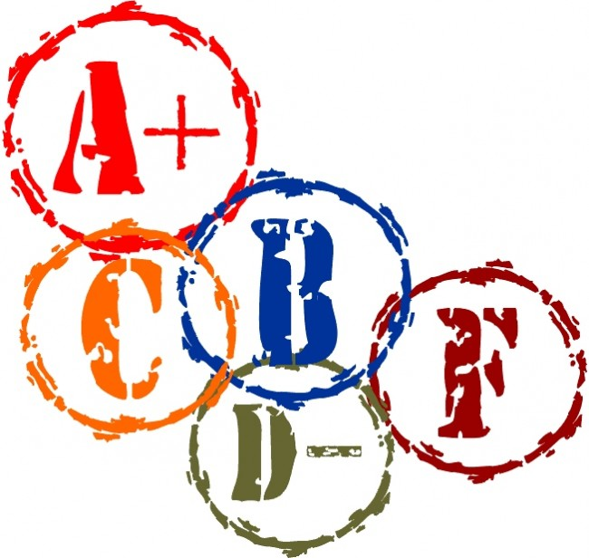
What are your grading gripes?
Share them on this Padlet:
https://bit.ly/PIE-gripes
This Photo by Unknown Author is licensed under CC BY-NC

Slide 4
Vanessa’s grading gripe
The assignment that makes you go hmmmm.

Slide 5
Lauren’s grading gripe
Time
This Photo by Unknown author is licensed under CC BY-NC.

Slide 6
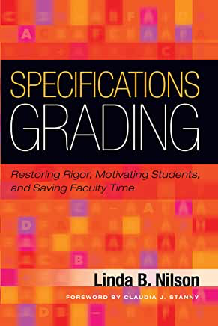
What is Specifications Grading?
A form of competency-based learning ("specs")
Assignments graded on a pass/fail basis
Competencies fully met or not fully met
Competencies met ≠ perfect
Final letter grade corresponds to competencies demonstrated

Slide 7
How Specifications Grading Works (1)
Assignment descriptions include clear specifications for student work
Students follow specifications when completing work
Grading is based on whether specifications are met

Slide 8
Example of specifications
This
NOT This
Pope, L., Parker, H. B., & Ultsch, S. (2020). Assessment of specifications grading in an undergraduate dietetics course. Journal of Nutrition Education and Behavior, 52(4), 439-446. https://doi.org/https://doi.org/10.1016/j.jneb.2019.07.017
This Photo by Unknown Author is licensed under CC BY-SA-NC

Slide 9
How Specifications Grading Works (2)

Slide 10
Got Tokens?
Students are afforded assignment tokens to:
Revise or redo assignments
Submit assignments late
Drop low grades
Waive assignments (typically low-point, participation assignments)

Slide 11
Why Specifications Grading?
Assessments align with learning outcomes
Requires clear expectations
Promotes mastery learning
Increases student control
Simplifies the grading process

Slide 12
How accurate are grades?
POLL:
In your course, do grades accurately represent student mastery of learning outcomes?
Yes, always
Sometimes
Not at all
I’m not sure

Slide 13
Our experience with specs grading
Master’s level class
First attempt
Reason: Provide students with meaningful option for less intensive class engagement
Undergraduate class
Second attempt
Reasons: Streamline grading, focus students on critical skills
Doctoral seminar
Third attempt
Reason: Remove stress, encourage writing

Slide 14
What do students think?
90% felt that they understood the system
29% felt it was difficult to adjust to the system
90% felt it was a fair system
90% felt more control over their grades
96% felt it encouraged mastery
86% felt it helped them earn the desired grade

Slide 15
Student feedback
Specifications grading was very efficient and gave me more control over my grades than other classes. With this grading scale, each time I submitted an assignment, I knew what my grade would be and the element of surprise that other classes have was completely eliminated (which is a good thing).
[The tokens] gave me a chance to submit an assignment late, in the case of a personal emergency, which usually tends to be a hassle in other classes.
I loved how it was only three ways to get a grade. Fail, pass, and high pass made it easier to get a better grade as well as redo an assignment instead of having a 70% and fixing your project just to get an 80% not a high pass or A. It taught me how to look at the assignments as learning skills not just a good grade.
It found it a little bit like the pass was very easy requirements while the high pass was way harder requirements and it felt like the high pass should’ve been worth more points.

Slide 16
How ready is your course for specs?
POLL:
Does your course have rubrics?
Yes, and they’re really clear
Yes, but they’re a little fuzzy
No, but there are grading criteria
No, there are minimal grading guidelines

Slide 17
Undergraduate Course Overview
Applied educational technology course designed for preservice teachers
Learning objectives:
Software skills
Design skills
Technology integration knowledge
Multi-section course
Face-to-face and online sections
Meets the university’s computer competency requirement

Slide 18
Undergraduate Course Assignment Overview
Skill Checks: Graded pass/fail
(80% of skills correct to pass)
Blog posts: Graded pass/fail
Graded in class activities (GICA): Graded pass/fail
Assignments: Graded high pass/pass/fail
Independent learning projects: Graded pass/fail
Study pool participation: Grade based on study pool credits earned
Final project: Graded out of 20 points

Slide 19
Undergraduate Assignment Example
Assignment: PowerPoint for Information Dissemination
Point Value: High Pass (5 points), Pass (3.5 points) and Fail (0 points)
Deliverables:
PowerPoint presentation
PowerPoint show

Slide 20
Undergraduate Assignment Example
Pass Specifications (3.5 points):
A title slide including the topic & your name
At least 6 content slides presenting instructional material
A closing slide that summarizes the important points and states the conclusion
At least 4 images/graphics
At least 3 different slide layouts used throughout the presentation
At least 1 traditional bulleted list
Animations on at least 2 slides
Slide design adheres to the Contrast, Repetition, Alignment and Proximity principles
Slides have few spelling or grammar errors
Narration on PowerPoint show is clear and easy to hear (quality audio recording)
TOTAL SLIDES: 8

Slide 21
Undergraduate Assignment Example
High Pass Specifications (5 points):
Meets ALL the criteria for PASS in addition to the following criteria:
At least 10 content slides presenting instructional material
At least 6 images/graphics, including an original graphic created using SmartArt
Add 1 slide layout to the existing Slide Master, name it 'Your_Name', and use this slide layout for at least 1 slide
At least 4 different slide layouts used throughout the presentation, including the slide layout you created
Slide number appears on all slides
File is set up so handouts will print with 'Your_Name' in the footer.
PowerPoint presentation file includes speaker notes for each slide indicating what the presenter will be doing and saying while the slide is projected.
Slides are free of spelling and grammar issues
Narration on PowerPoint Show is scripted and well organized
TOTAL SLIDES: 12

Slide 22
Undergraduate Course Tokens
2 late assignment tokens
3 assignment revision/redo tokens
1 waived blog post token
1 waived graded in-class activity token

Slide 23
Setting Up Tokens in Canvas

Slide 24
Tracking Tokens in Canvas

Slide 25
Opportunities to Earn Additional Tokens
This Photo by Unknown author is licensed under CC BY-SA.

Slide 26
Alternate grading schemes: Bundling
Assignment | B- or lower | B | B+ | A- | A
Participation | See syllabus for details of grade calculation. | Choose 1 to complete for entire course | Choose 1 to complete for entire course | Complete for entire course | Complete for entire course
Blogs |  |  |  | Complete for entire course | Complete for entire course
Produsage |  | Present concept (design paper) | Concept + execution | Concept + execution + example | Concept + execution + example + reflective critique
Community Observation Knowledge Sharing & Tracking Personal Learning Network |  | 0 as full assignment, 3 as concept assignments | 1 as full assignment, 2 as concept assignments | 2 as full assignments, 1 as concept assignment | All 3 as full assignments

Slide 27
Alternate grading schemes: Mix & match
Graded via specifications grading
4 (out of 6) one-page papers
Annotated bibliography
Presentation (2)
Peer feedback (3)
Graded for points using a rubric:
Final portfolio (35% of grade)

Slide 28
Lessons Learned
Clear assignment expectations = Increased student confidence
Students submitted strong work no matter which version they completed
Students engaged in greater self-regulation
Instructors spent less time determining grades and more time providing feedback
Students read and attended to feedback
Instructors experienced less “grade grubbing”

Slide 29
Lessons Learned
Some undergraduate students
Struggled to adjust to specifications grading on a conceptual level
Tried to negotiate for higher grades without making revisions
As with all course designs, adjustment may be needed after initial implementation.

Slide 30
Using Specs Grading: Course Level Conversion
Examine existing grading scheme
Do students need to complete all assignments to pass the course?
How do existing assignments align with course objectives?
Are there different ways to demonstrate mastery of objectives?
Can students have multiple attempts?
Can students skip small/interim assignments?
Choose assignments to convert to specs approach
Start small if you’re unsure
Identify a target grade (e.g., C for undergrads, B for grads)
Determine minimum acceptable demonstration of learning for achieving target

Slide 31
Using Specs Grading: Assignment Level Conversion
Examine existing assignment
Is there already a rubric? Does the rubric provide clear, measurable guidance?
Are there assignment-level objectives? Do they provide guidance?
Identify where students have struggled in the past
Develop / clarify specifications
Choose level(s) or benchmark(s) for meeting specifications

Slide 32
Talking to your supervising instructor
Talking points about specs:
Helps ensure students have mastered the learning objectives
Teaches students to follow directions and attend to learning objectives
Discourages shoddy work
Streamlines the grading process
Reduces student appeals / grade grubbing
Initial investment in design pays off quickly
Can start with baby steps (just 1-2 assignments)

Slide 33
Communicating with students about specs
Introduce the system at the beginning of class
Remind students to follow the specs when completing assignments
Remind students to use tokens for revisions
Provide enough tokens to give students a chance to learn the system without penalty

Slide 34
Discussion
Handouts:
Specs Grading Planning Guide Course Level – https://bit.ly/SGPG_CL
Specs Grading Planning Guide Assignment Level – https://bit.ly/SGPG_AL
How can you apply specifications grading to your course assignments?
https://bit.ly/PIE-possibilities

Slide 35
Thanks for joining us!
Any questions?
Vanessa Dennen – vdennen@fsu.edu - @vdennen
Lauren Bagdy – Lbagdy@fsu.edu - @laurenbagdy

