Slide 1
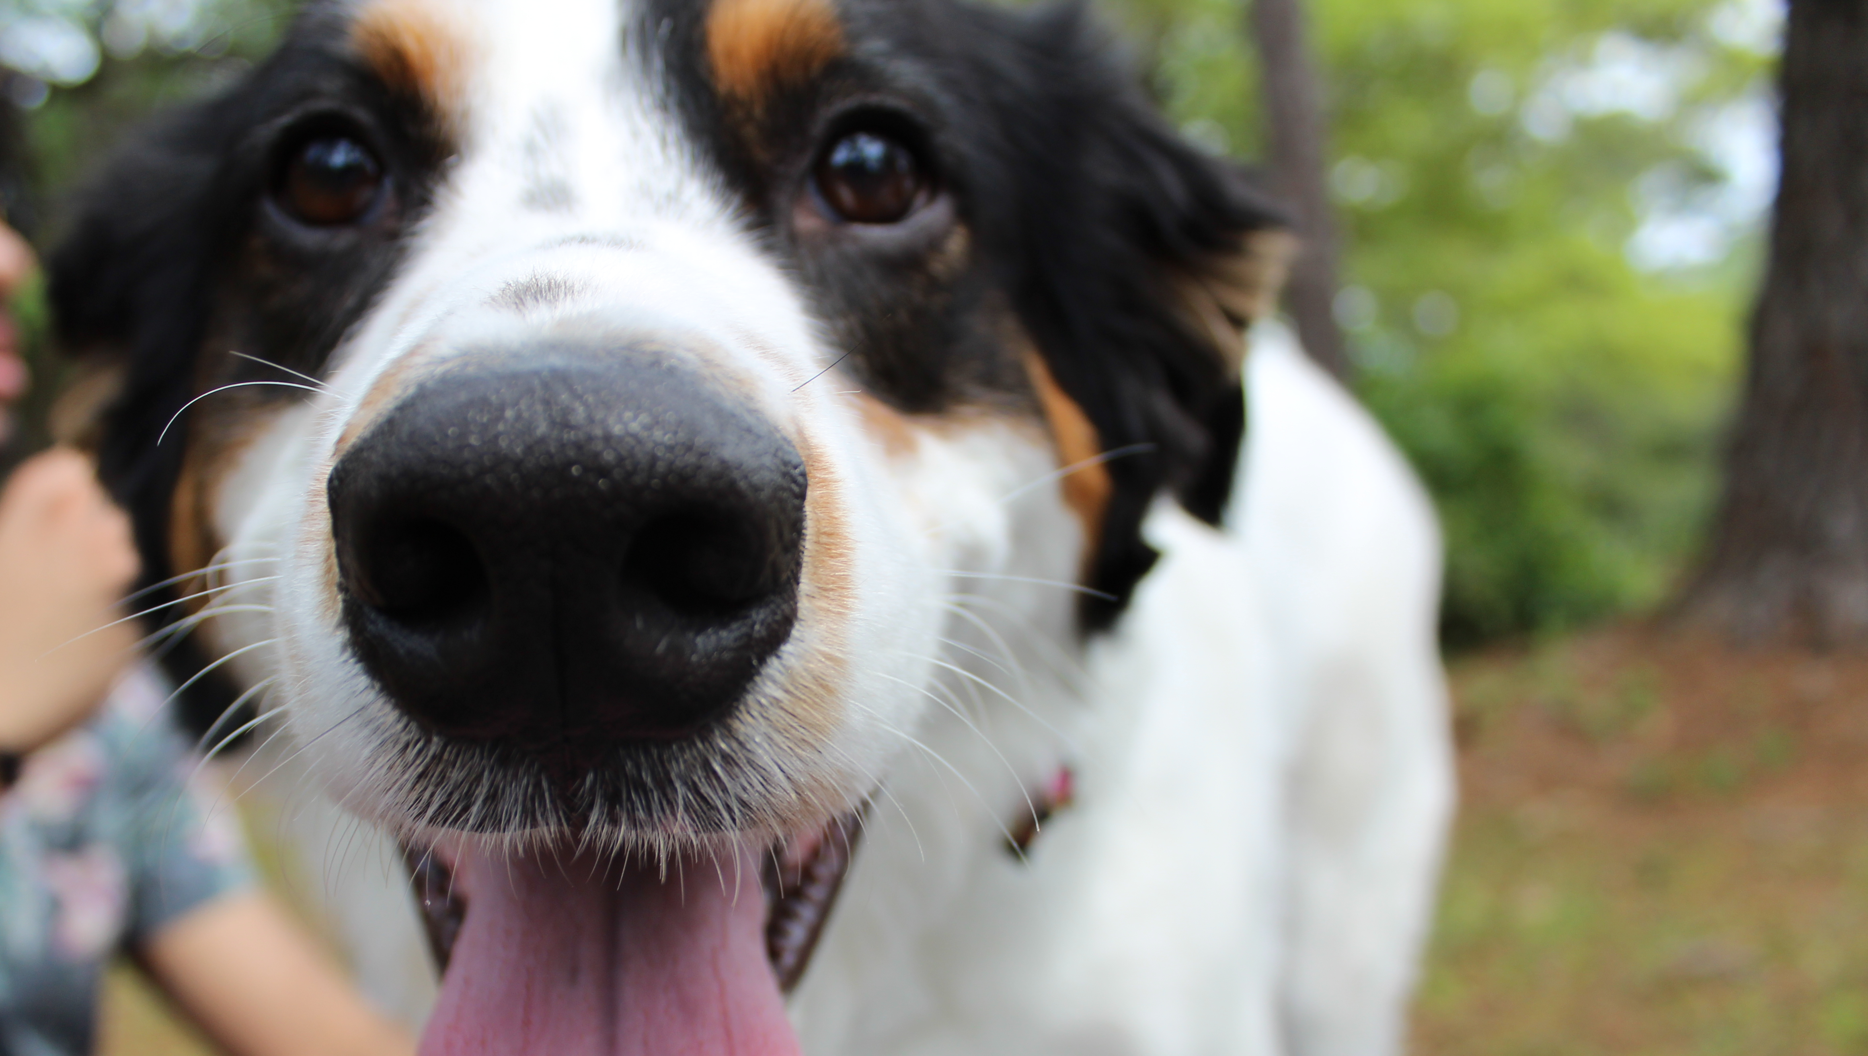
PIE COFFEE HOURS: STEM Panel
Cera Hsu - Chemistry

Slide 2
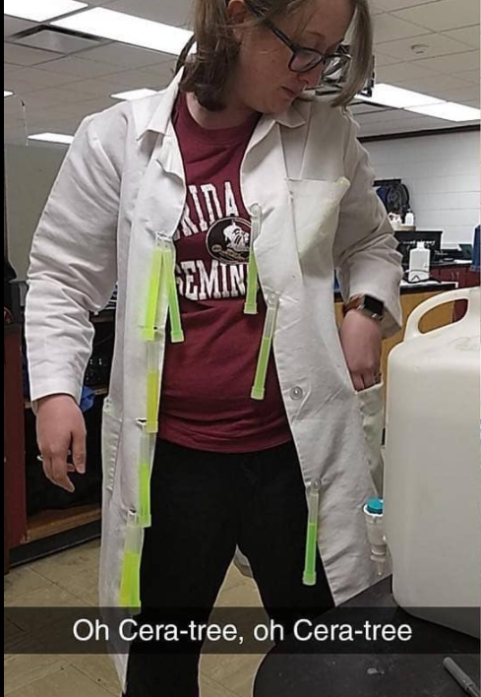
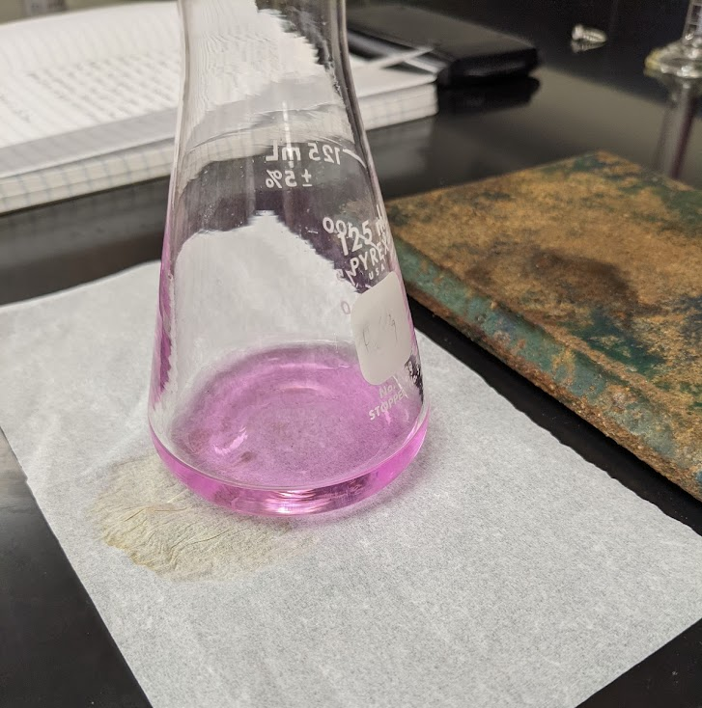
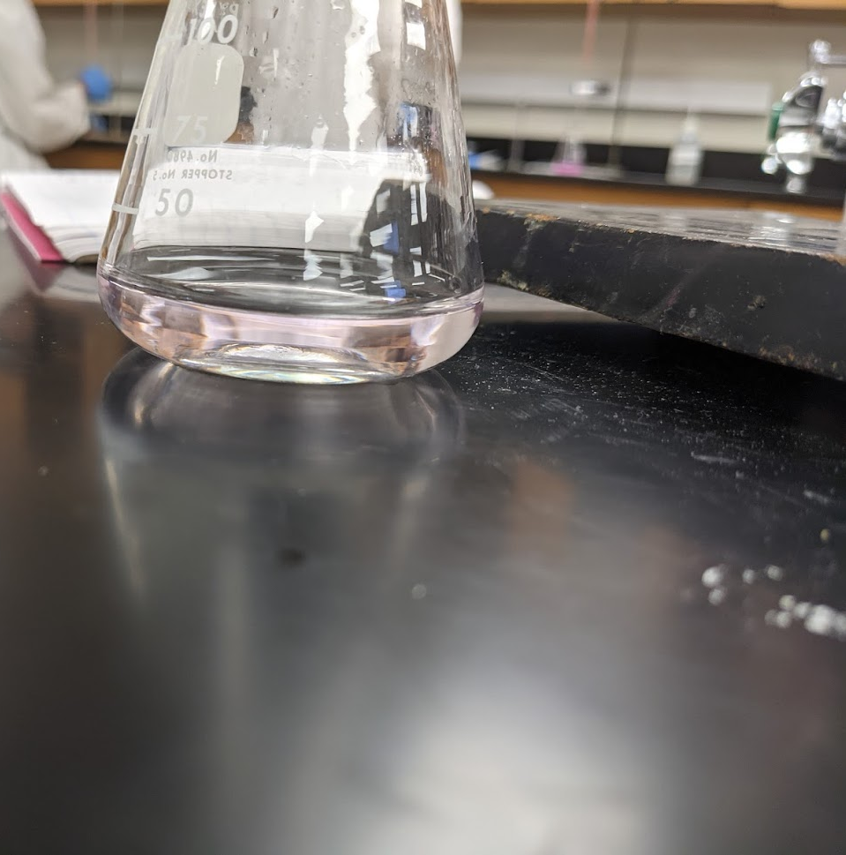
Teaching labs….
Create a fun learning environment
Keep conversations flowing with the students and encourage conversation between the students
Create some fun with the experiments: titrations for example…

Slide 3
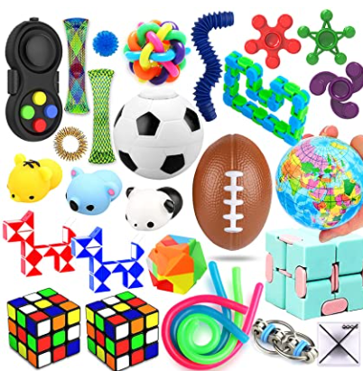
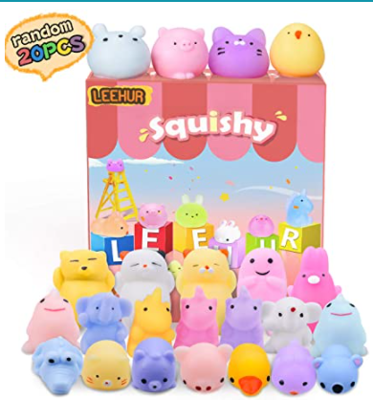
Teaching Recitations..
Keep students engaged
Open conversations
Try not to have the same student answer ALL the questions (there’s always one student)
Try new activities
Kahoot
Surveys
Open ended questions
Group competition (group work on problem solving)
Of course this applies to pre-COVID times….so what now??

Slide 4
Teaching STEM during COVID
Zoom is the new normal…so how do we adjust to this environment?
My iPad has been my hero (I’ll demonstrate)
Before I had the Samsung S6 lite tablet, and it worked just a great
You can still show videos and fun activities like Kahoot

