Slide 1
Conflict in the Classroom

Slide 2
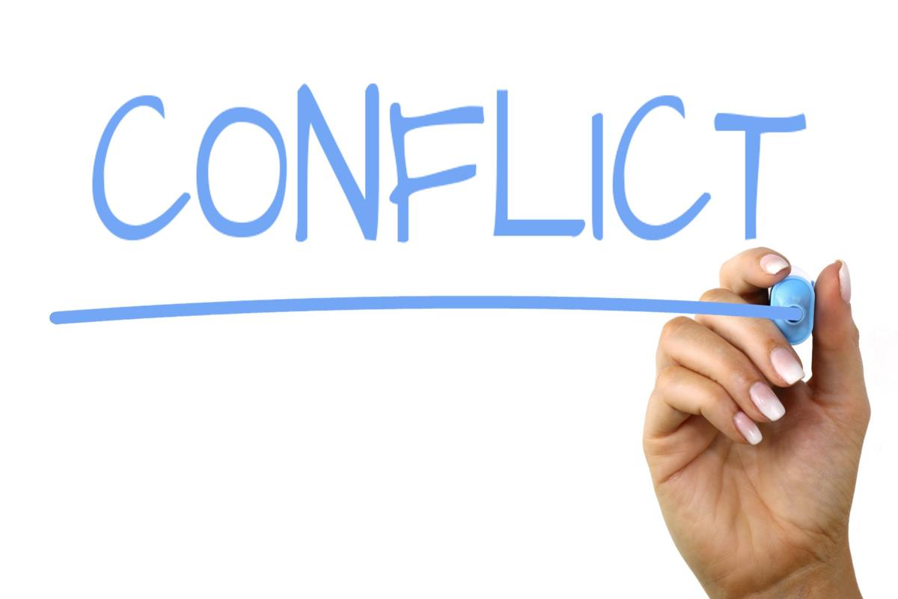
Today we’ll cover:
The Stakes Of Conflict Management
Preparations You Can Make Before Anticipated Conflict
Strategies For In The Moment Conflict Resolution
Actions To Take After Intense Conflict

Slide 3
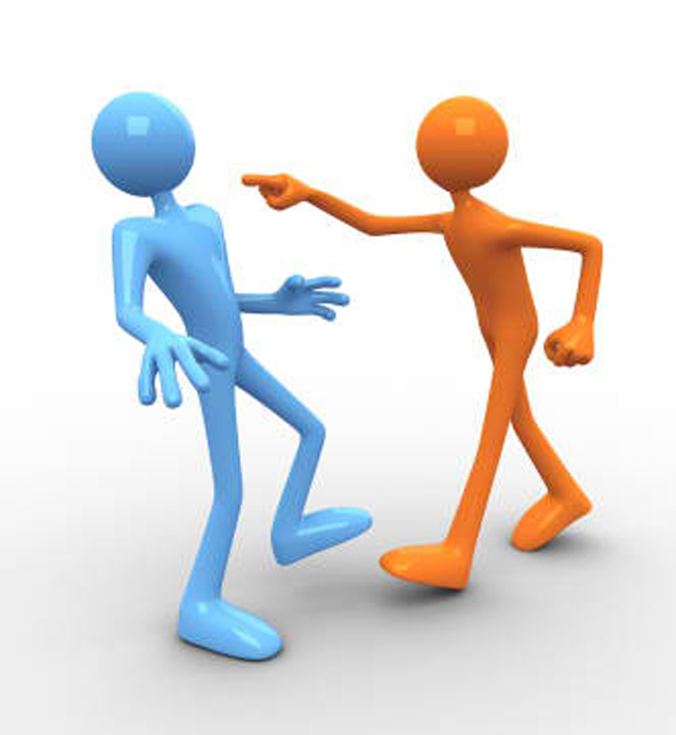
The Stakes Of Conflict Management
The Reputation of your Department
Your Students’ Willingness/Ability to Learn
Your Reputation

Slide 4
Managing Hot Moments In The Classroom
“‘We were ten weeks into Introduction to Afro-Am and were discussing Louis Farrakhan,’ a young instructor told me. ‘Near the end of section, a very smart Jewish woman said, ‘Only uneducated black men would believe in Farrakhan.’ Six black men in the class turned on her and attacked. ‘Class ended, and she ran out of the room, down the hall, in tears.’
‘I went after her and told her that if she was ever going to understand this stuff she had to go back the next time and listen very hard to what those guys, highly educated, say about why they might believe in Farrakhan.’
‘I then went back into the classroom. Luckily the men were still there, still talking about the incident. I told them that if they were ever going to get it, they had to listen very hard to why a Jewish woman might think that only the uneducated would believe in Farrakhan.’
This young man was able to turn a hot moment into a profound learning opportunity for his students. He did it by keeping his head, not taking sides, and letting both groups know that they would gain immeasurably by understanding the arguments of the other side.”

Slide 5
Preparations You Can Make Before Anticipated Conflict
Set classroom goals/expectations
Prepare for the conflict you *can* anticipate
Treat each lecture like an essay - highlighting up front the content you are covering so students can mentally prepare

Slide 6
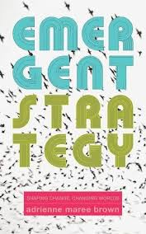
Setting Goals and Expectations
Small is good, small is all. (The large is a reflection of the small.)
Change is constant. (Be like water.)
There is always enough time for the right work.
There is a conversation in the room that only these people in this moment can have. Find it.
Never a failure, always a lesson.
Trust the people. (If you trust the people, they become trustworthy).
Move at the speed of trust. Focus on critical connections more than critical mass - build the resilience by building the relationships.
Less prep, more presence.
What you pay attention to grows. (pg 32)

Slide 7
Preparing for Anticipated Conflict
Some sites of tension, you can anticipate. Are you talking about abortion? Slavery? Sexuality? Does what you’re teaching that day have the potential to substantially shake someone’s worldview? I hope so! But if so…
What kinds of questions are you willing to entertain and for how long? Building in time for questions can make you feel less pressured/rushed and enable you to respond to students more patiently.
Are you going to dismiss certain types of concerns as not relevant to the topic at hand? What would that look like? Plan that language ahead of time.
Are you going to offer them resources for further study on their own time? If so, what will those be? Be prepared.

Slide 8
Treat Each Lecture Like an Essay
Essays have an intro, body, and conclusion. You lectures can have the same.
Tell them what you’re going to address in lecture that day before you actually get there. This would be the time to issue a trigger warning. I.e. “Today we will be discussing x. These particular components may be distressing.” And give them appropriate modes of action if they feel uncomfortable, remind them of the rules of conduct, etc. If you want questions held to the end, you can say there here also.
Deliver the body of the lecture
Resummarize the content of the lecture either at the end or the beginning of the next class.
Time for questions

Slide 9
Strategies For In The Moment Conflict Resolution
Refer back to class discussion guidelines you have set.
Avoid negative or pointed statements. Use inclusive, positive language. I.e. “Remember, we want to be x as we engage with each other. Can you rephrase?”
Sometimes conflict starts from simple misunderstanding. That can be avoided by echoing back to your students when something they have said is unclear to you - “What I’m hearing you say is xyz, is that right?” This also gives them a moment to rethink their words.
Taking the question out of the “public” sphere of the classroom and ask the student to discuss these things with you later.
Calling in & Calling out

Slide 10
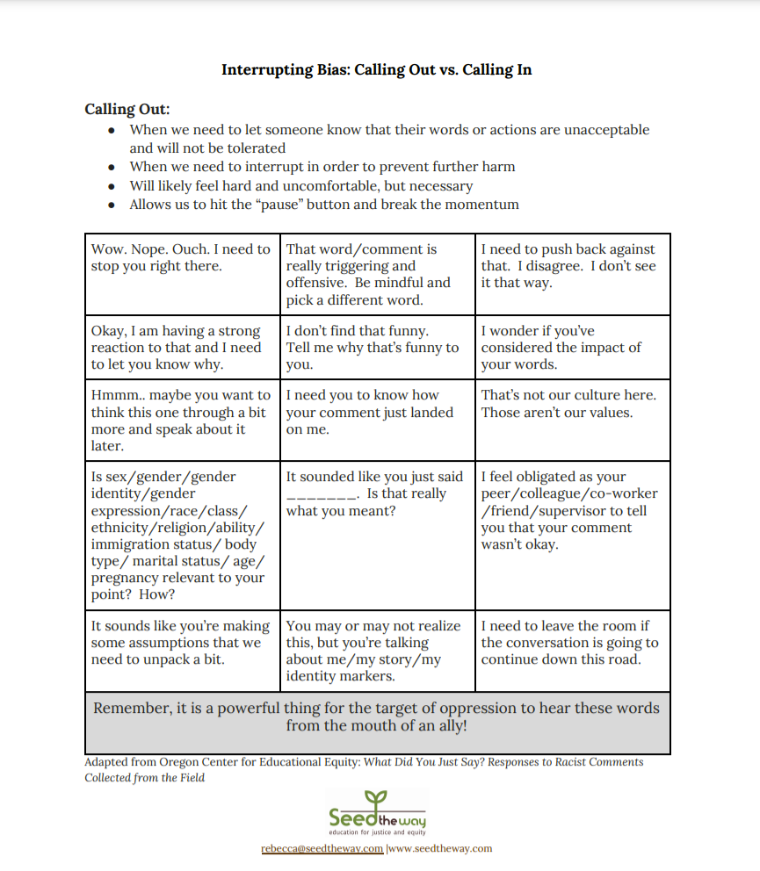

Slide 11
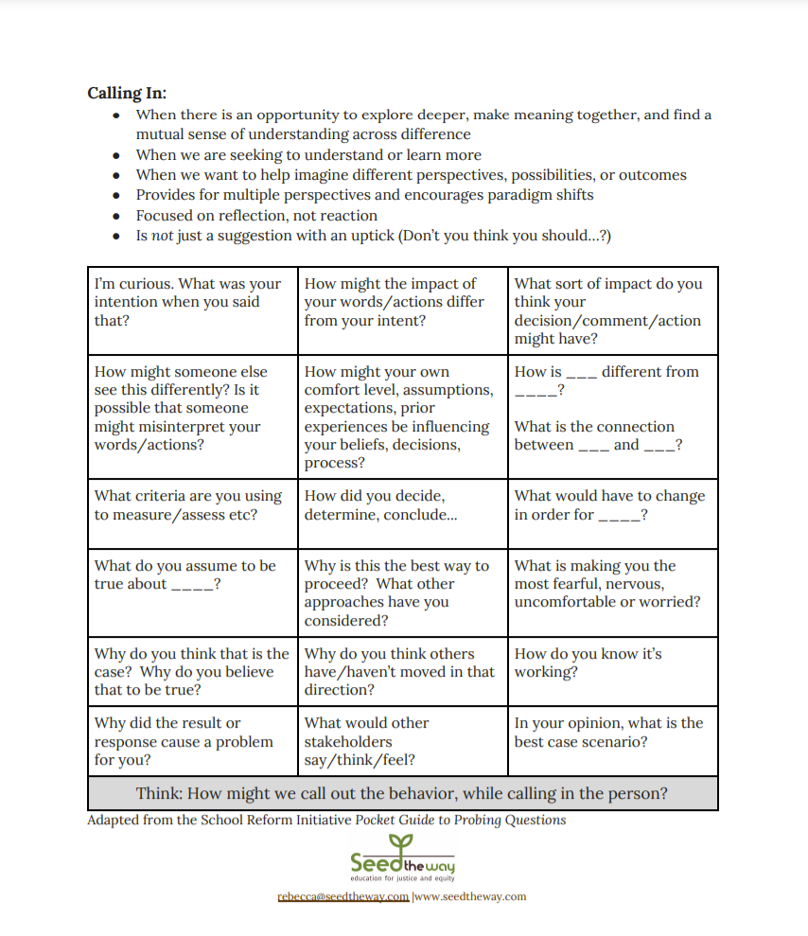

Slide 12
Actions To Take After Intense Conflict
Thank your students for engaging
Follow up after class with any students who seemed particularly distressed
Invite all of your students to your office hours for further discussion of the topic(s) if they are concerned
Email the department chair and/or undergraduate director - our own Adam Gaiser - if anything seems to get particularly out of hand. Explain what happened and what steps you took to resolve it. Better to over-communicate than under-communicate.

Slide 13
Teaching Online Changes Things
70-93% of communication is nonverbal. This means that any of your communication with your students where they cannot see you is *severely* hampered. This extends from emails to discussion boards to days your camera might not be working. Where in a synchronous, in-class lecture a student might make a problematic comments and you gently correct them or change the topic, that gentleness can easily be lost when your students are missing 70-93% of the data they use to determine how they are being treated. This is going to require greater intentionality with the language that you use.

Slide 14
Need Further Help?
TA Community Support Site on Canvas: https://canvas.fsu.edu/courses/130419
PIE Coffee Hour and Teaching Workshop Series: https://pie.fsu.edu/
FSU’s Center for the Advancement of Teaching: pro-teaching@fsu.edu
Questions for me now?

Slide 15
Fin

